Slide 1
Neural Language Models
Kyunghyun Cho
New York University
Courant Institute (Computer Science) and Center for Data Science
Facebook AI Research

Slide 2
Language Modelling
Input: a sentence
Output: the probability of the input sentence
A language model captures the distribution over all possible sentences.
Unlike text classification, it is unsupervised learning.
We will however turn the problem into a sequence of supervised learning.

Slide 3
Autoregressive language modelling
Autoregressive sequence modelling
The distribution over the next token is based on all the previous tokens.
This equality holds exactly due to the def. of conditional distribution*
Unsupervised learning becomes a set of supervised problems.
Each conditional is a neural network classifier.
Input is all the previous tokens (a partial sentence).
Output is the distribution over all possible next tokens (classes).
It is a text classification problem.
* See Lecture 1.

Slide 4
Autoregressive language modelling
Autoregressive sequence modelling
The distribution over the next token is based on all the previous tokens.
Each conditional is a sentence classifier:
Table Lookup
Table Lookup
Softmax
Sentence
Representation
Extractor*
An arbitrary
sub-graph
Average
Table Lookup
* See Lecture 2.

Slide 5
Autoregressive language modelling
Autoregressive sequence modelling
Loss function: the sum of negative log-probabilities
Table Lookup
Table Lookup
Softmax
Sentence
Representation
Extractor*
An arbitrary
sub-graph
Average
Table Lookup
NLLLoss

Slide 6
Scoring a sentence
Autoregressive sequence modelling
The distribution over the next token is based on all the previous tokens.
A natural way to score a sentence:
In Korea, more than half of residents speak Korean.
“In” is a reasonable token to start a sentence.
“Korea” is pretty likely given “In”
“more” is okay token to follow “In Korea”
“than” is very likely after “In Korea, more”
“half” is also very likely after “In Korea, more than”
Sum all these scores and get the sentence score.

Slide 7
Scoring a sentence
Autoregressive sequence modelling
The distribution over the next token is based on all the previous tokens.
A natural way to score a sentence:
“In Korea, more than half of residents speak Korean.” vs. “In Korea, more than half of residents speak Finnish.”
The former is more likely (=higher probability) than the latter.
This is precisely what computes over the sentence.
NLLLoss

Slide 8
N-Gram Language Models
Let’s back up a little…
What would we do without a neural network?
We need to estimate n-gram probabilities:
Recall the def. of conditional and marginal probabilities:
: all possible tokens (=vocabulary)

Slide 9
N-Gram Language Models
We need to estimate n-gram probabilities:
How do we estimate the probability?
I want to estimate the probability of my distorted coin landing head.
Maximum likelihood estimation (MLE): toss the coin a lot and look at how often it lands heads.
Data Collection
Estimation

Slide 10
N-Gram Language Models
We need to estimate n-gram probabilities:
Data: all the documents or sentences you can collect
e.g., Wikipedia, news articles, tweets, …
Estimation:
Count the # of occurrences for the n-gram
Count the #’s of occurrences for all the n-grams of the form:

Slide 11
N-Gram Language Models
We need to estimate n-gram probabilities:
Estimation:
Do you see why this makes sense?

Slide 12
N-Gram Language Models
We need to estimate n-gram probabilities:
How likely is “University” given “New York”?
Count all “New York University”
Count all “New York ?”: e.g., “New York State”, “New York City”, “New York Fire”, “New York Police”, “New York Bridges”, …
How often “New York University” happens among these?

Slide 13
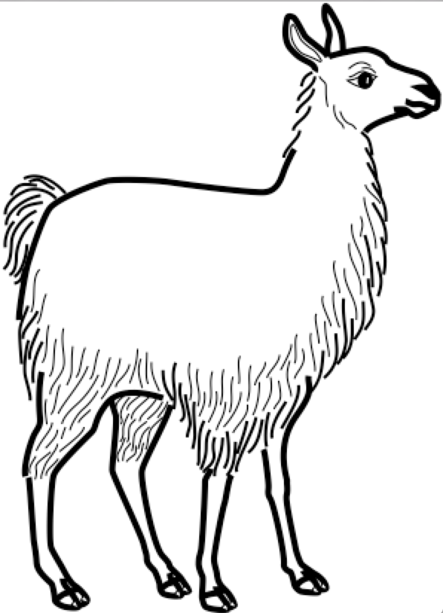
N-Gram Language Models – Two problems
Data sparsity: lack of generalization
What happens “one” n-gram never happens?
Inability to capture long-term dependencies
Each conditional only considers a small window of size n.
Consider “the same stump which had impaled the car of many a guest in the past thirty years and which he refused to have removed”
It is impossible to tell “removed” is likely by looking at the four preceding tokens.

Slide 14
Traditional Solutions
Data Sparsity
Smoothing: add a small constant to avoid 0.
Backoff: try a shorter window.
The most widely used approach: Kneser-Ney smoothing/backoff
KenLM implements the efficient n-gram LM model.

Slide 15
Traditional Solutions
Long-Term Dependency
Increase n: not feasible as the data sparsity worsens.
# of all possible n-grams grows exponentially w.r.t. n:
The data size does not grow exponentially: many never-occurring n-grams.
These two problems are closely related and cannot be tackled well.
To capture long-term dependencies, n must be large.
To address data sparsity, n must be small.
Conflicting goals..

Slide 16
N-Gram Language Models – Two problems
Data sparsity: lack of generalization
What happens “one” n-gram never happens?
Inability to capture long-term dependencies
Each conditional only considers a small window of size n.
Consider “the same stump which had impaled the car of many a guest in the past thirty years and which he refused to have removed”
It is impossible to tell “removed” is likely by looking at the four preceding tokens.

Slide 17
Neural N-Gram Language Model [Bengio et al., 2001]
The first extension of n-gram language models using a neural network
Table Lookup
Table Lookup
Softmax
Sentence
Representation
Extractor*
An arbitrary
sub-graph
Concatenation
Table Lookup

Slide 18
Neural N-Gram Language Model
The first neural language models
Trained using backpropagation and SGD: see Lecture 1
Generalizes to an unseen n-gram
Addresses the issue of data sparsity
How?
Table Lookup
Table Lookup
Softmax
Sentence
Representation
Extractor*
An arbitrary
sub-graph
Concatenation
Table Lookup

Slide 19
Neural N-Gram Language Model
Why does the data sparsity happen?
A “shallow” answer: some n-grams do not occur in the training data, while they do in the test time.
A “slightly deeper” answer: it is difficult to impose token/phrase similarities in the discrete space.
Table Lookup
Table Lookup
Softmax
Sentence
Representation
Extractor*
An arbitrary
sub-graph
Concatenation
Table Lookup

Slide 20
Neural N-Gram Language Model
Why does the data sparsity happen?
Back to the earlier example
Problem:
Observation:
If the LM knew “llama” is a mammal similar to “cat”, “dog” and “deer”, it would be able to guess ”chasing a llama” is as likely as “chasing a cat”, “chasing a dog”, and “chasing a deer”.
Table Lookup
Table Lookup
Softmax
Sentence
Representation
Extractor*
An arbitrary
sub-graph
Concatenation
Table Lookup

Slide 21
Neural N-Gram Language Model
The neural n-gram language model addresses this issue by “learning the similarities” among tokens and phrases in a “continuous vector space”.
In the “continuous vector space”, similar tokens/phrases are nearby: e.g., word2vec [Mikolov et al., 2013; Pennington et al., 2014], doc2vec [Le&Mikolove, 2014], sentence- to-vec [Hill et al., 2016 and ref’s therein]
Then, similar input n-grams lead to similar output:
Table Lookup
Table Lookup
Softmax
Sentence
Representation
Extractor*
An arbitrary
sub-graph
Concatenation
Table Lookup

Slide 22
Neural N-Gram Language Model
Training examples
there are three teams left for qualification.
four teams have passed the first round.
four groups are playing in the field.
Q: how likely is “groups” followed by “three”?
Table Lookup
Table Lookup
Softmax
Sentence
Representation
Extractor*
An arbitrary
sub-graph
Concatenation
Table Lookup
Continuous vector space
three
teams
four
groups

Slide 23
Neural N-Gram Language Model
In practice,
Collect all n-grams from the corpus.
Shuffle all the n-grams to build a training set
Train the neural n-gram language model using stochastic gradient descent on minibatches containing 100-1000 n-grams.
Early-stop based on the validation set.
Report perplexity on the test set.
Table Lookup
Table Lookup
Softmax
Sentence
Representation
Extractor*
An arbitrary
sub-graph
Concatenation
Table Lookup

Slide 24
Increasing the context size – Convolutional Language Models [Kalchbrenner et al., 2015; Dauphin et al., 2016]
Dilated convolution to rapidly increase the window size
Exponential-growth of the window by introducing a multiplicative factor
By carefully selecting the multiplicative factor, no loss in the information.

Slide 25
Increasing the context size – Convolutional Language Models [Kalchbrenner et al., 2015; Dauphin et al., 2016]
Dilated convolution to rapidly increase the window size
Causal convolution: the future tokens cannot be used.
Computation as usual: efficiency
Clever masking of future tokens: causality
Efficient computation + larger context
ByteNet [Kalchbrenner et al., 2015]
PixelCNN, WaveNet, …
Gated Convolutional Language Model [Dauphin et al., 2016]
Softmax

Slide 26
Causal sentence representation and language modelling
Any sentence representation learning method from Lecture 2 could be used as long as it does not break the generative story:
In addition to the feedforward and convolutional n-gram language models, we can use any of the remaining sentence representation.
<bos>
It
explicitly
models
dependencies
<eos>

Slide 27
Infinite context n→∞ – CBoW Language Models
Equivalent to the neural LM after replacing “concat” with “average”
“Averaging” allows the model to consider the infinite large context window.
Extremely efficient, but a weak language model
Ignores the order of the tokens in the context windows.
Any language with a fixed order cannot be modelled well.
Averaging ignores the absolute counts, which may be important:
If the context window is larger, “verb” becomes less likely in SVO languages.

Slide 28
Infinite context n→∞ – Recurrent Language Models [Mikolov et al., 2010]
A recurrent network summarizes all the tokens so far.
Use the recurrent network’s memory to predict the next token.
Efficient online processing of a streaming text:
Constant time per step.
Constant memory throughout forward computation
Useful in practice:
Useful for autocomplete and keyword suggestion.
Scoring partial hypotheses in generation.
Softmax
RNN
RNN
RNN

Slide 29
Infinite context n→∞ – Recurrent Memory Networks [Tran et al., 2016]
The recurrent network solves a difficult problem: compress the entire context into a fixed-size memory vector.
Self-attention does not require such compression but still can capture long-term dependencies.
Combine these two: a recurrent memory network (RMN) [Tran et al., 2016]
RNMT+: a similar, recent extension for neural machine translation
Softmax
Weighting
Function
Summation
RN
RNN
RNN
RNN
RNN
RNN
RNN
RNN
RNN
RNN
RNN
RNN

Slide 30
So far, we learned
What autoregressive language modelling is:
How autoregressive language modelling transforms unsupervised learning into a series of supervised learning:
It is a series of predicting the next token given previous tokens.
How neural language modelling improves upon n-gram language models:
Continuous vector space facilitates generalization to unseen n-grams.
Infinitely large context window
How sentence representation extraction is used for language modelling:
Convolutional language models, recurrent language models and self-attention language models..

Slide 31
Recurrent Networks and Backpropagation
Abstraction can sometimes blind us.
Opening the box can sometimes teach us a lot.
We will open the box called RNN and see what happens inside.
Softmax
RNN
RNN
RNN

Slide 32
Backpropagation
Consider a computational path from one parameter to the loss
Backpropagation computes by sequentially multiplying Jacobians

Slide 33
Backpropagation
Backpropagation computes by sequentially multiplying Jacobians
At each step,
How much influence does my input have on my output?
How much influence does my output have on the loss function?

Slide 34
Backpropagation
We can analyze the behavior of backpropagation by inspecting each of or a group of Jacobian matrices.
What are singular values of the L-th Jacobian?
How are singular values of the product of L’ Jacobians distributed?
How much influence does my input have on my output?
How should I adjust my output to maximize/minimize the loss?

Slide 35
Backpropagation for Naïve Recurrent Network
RNN
Naïve recurrent networks are implemented with a tanh RNN box
Table Lookup
MatMul
MatMul

Slide 36
Backpropagation for Naïve Recurrent Network
RNN
Naïve recurrent networks are implemented with a tanh RNN box
Table Lookup
MatMul
Table Lookup
MatMul
Table Lookup
MatMul
MatMul
MatMul
MatMul

Slide 37
Backpropagation for Naïve Recurrent Network
RNN
Naïve recurrent networks are implemented with a tanh RNN box
The gradient of the loss w.r.t. the (flattened) weight matrix W is then , where is a copy of used at time .
Consider for simplicity, and expand it as
A chain of temporal derivatives shows up.

Slide 38
Backpropagation for Naïve Recurrent Network
A chain of temporal derivatives shows up.
How does one-step temporal derivative look like?* where .
Then,
* I really wish I haven’t messed up here with a transpose…

Slide 39
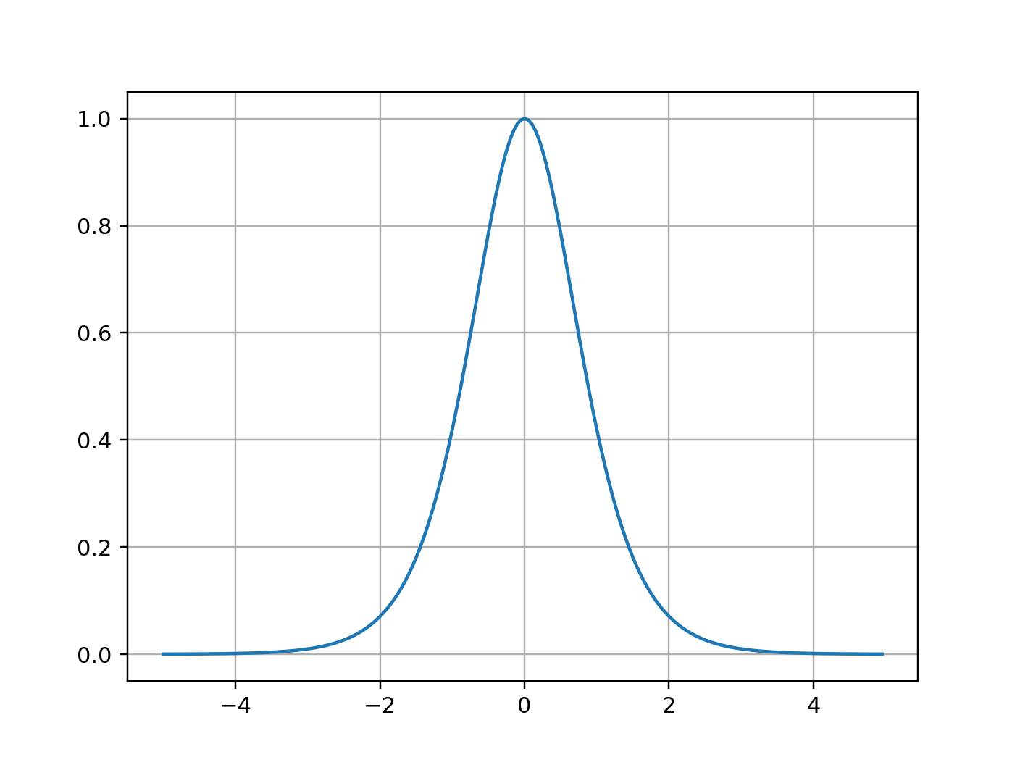
Backpropagation for Naïve Recurrent Network
The n-step temporal derivative
A few notes
is a square matrix
Consequence: vanishing gradient

Slide 40
Backpropagation for Naïve Recurrent Network
The norm of the n-step temporal derivative
Let’s consider a scalar for intuition:
If W > 1, (the upperbound of) the norm blows up → exploding gradient
If W < 1, (the upperbound of) the norm shrinks to zeros → vanishing gradient
With a (square) matrix W:
If the largest eigenvalue of W > 1, exploding gradient
If the largest eigenvalue of W < 1, vanishing gradient

Slide 41
Backpropagation for Naïve Recurrent Network
The norm of the n-step temporal derivative
The fundamental issue of deep learning [Hochreiter, 1992; Bengio et al., 1994]
A similar phenomenon happens with a feedforward network:
As W’s are not shared, exploding gradient less likely: they are not axes-aligned.
Vanishing gradient however can easily happen: though, it is more due to the bounded derivative of activation functions.

Slide 42
Exploding gradient is not an issue (in practice)
Exploding gradient turned out to be a non-issue
“One difficulty when training LSTM with the full gradient is that the derivatives sometimes become excessively large … all the experiments in this paper clipped the derivative of the loss with respect to the network inputs to the LSTM layers ...¹” ¹ “In fact this technique was used in all my previous papers on LSTM, and in my publicly available LSTM code, but I forgot to mention it anywhere—mea culpa.” (Graves, 2013)
“A simple solution to the exploding gradient problem is to truncate values of the gradients. In my experiments, I did limit maximum size of gradients of errors that get accumulated in the hidden neurons to be in a range < −15; 15 >.” (Mikolov, 2012)

Slide 43
Exploding gradient is not an issue (in practice)
“when gradients explode so does the curvature along v, leading to a wall in the error surface” (Pascanu et al., 2013)
Gradient clipping has become standard (for both RNN and FF-NN)
Pascanu et al. (2013)

Slide 44
Vanishing gradient is super-problematic!
We cannot tell why the vanishing gradient happens
Learning is done!
All long-term dependencies have been captured and there is nothing to do.
Wrongly configured parameters
We only observe the vanishing norm of the temporal derivative.

Slide 45
Vanishing gradient is super-problematic!
Perhaps, the issue is the “layered” structure.
(forward) repeated affine+nonlinearity
(backward) product of matrices
What if we introduce short-cut (or skip) connections?

Slide 46
Gated recurrent units
Naïve transition:
Adaptive shortcut:
Candidate update
Update gate

Slide 47
Gated recurrent units
Naïve transition:
Adaptive shortcut:
Candidate update+pruning
Update gate
Reset gate

Slide 48
Gated recurrent units are more realistic
Naïve transition vs. CPU
Registers
Execution
Read the whole register
Update the whole register

Slide 49
Gated recurrent units are more realistic
GRU vs. CPU
Registers
Execution
Select a readable subset
Read the subset
Select a writable subset
Update the subset

Slide 50
Lessons from GRU/LSTM
Credit assignment over a long path of computation is difficult
Credit/blame is overly emphasized (exploding gradient) or overly dampened (vanishing gradient)
Credit/blame become diluted because of the exponentially many paths.
Adaptive shortcut or skip-connection helps avoid credit dilution
LSTM [Hochreither&Schmidhuber, 1999], GRU [Cho et al., 2014]
Highway newtorks [Srivastava et al., 2015], ResNet [He et al., 2015]
Attention mechanism [Bahdanau et al., 2014]
Gates are an effective way to focus credit assignment
LSTM, GRU, highway networks, gated linear units [Dauphin et al., 2016], Attention mechanism

Slide 51
So far, we have learned…
Language modelling
What neural autoregressive modelling is…
Various ways to capture a sequence distribution using a neural network
Continuous representation and its ability to capture semantic similarities
Recurrent networks
Backpropagation through time and exploding/vanishing gradient
Gated recurrent units and LSTM

Slide 52
So far, we learned
What autoregressive language modelling is:
How autoregressive language modelling transforms unsupervised learning into a series of supervised learning:
It is a series of predicting the next token given previous tokens.
How neural language modelling improves upon n-gram language models:
Continuous vector space facilitates generalization to unseen n-grams.
Infinitely large context window
How sentence representation extraction is used for language modelling:
Convolutional language models, recurrent language models and self-attention language models..

Slide 53
In the next lecture,
Sequence-to-Sequence Learning: Neural Machine Translation [Sutskever et al., 2014; Cho et al., 2014; Kalchbrenner&Blunsom, 2013]

